Slide 1

GREENLIGHT MILESTONE
Travis Moore
thedevilswaffle@gmail.com
www.thedevilswaffle.com
GAT 316 Fall 2016
Section A
Professor: Richard Rowan

Slide 2
telefrag d
’

Slide 3
OVERVIEW
Telefrag’d is a 3D multiplayer action arcade game that pits 2 – 4 players against one another in a hazard filled arena.

Slide 4
CORE GAMEPLAY
Be the last player standing!
How?
Bump your opponents into hazards or teleport into them to burst them from the inside-out.

Slide 5
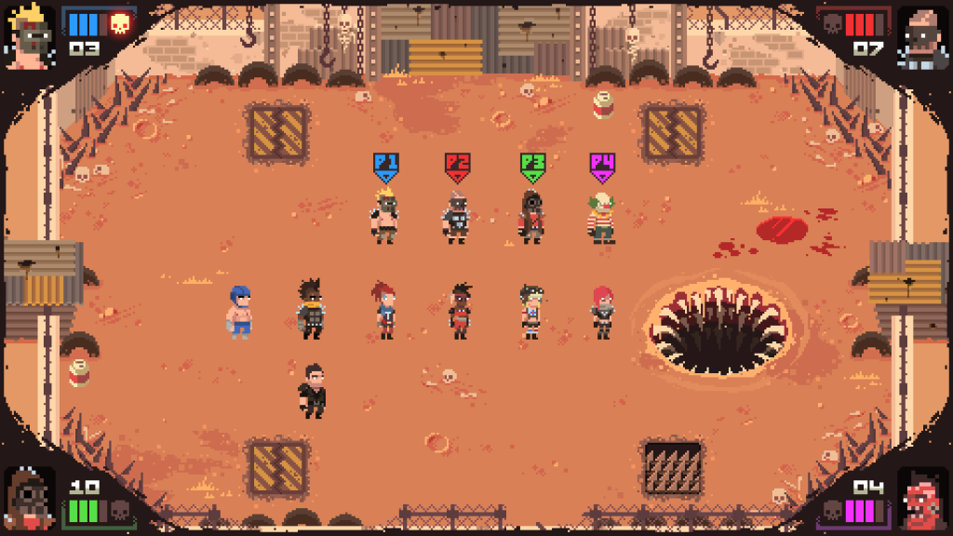
INFLUENCES
Similar to the gameplay of Super Splataclysm

Slide 6
PROPOSED FEATURES
3D Top Down Camera
2D Movement & Mechanics
Simple Controls – Teleporting & Shield
Arena Filled with Hazards
Humorous & Absurd Deaths
Quick, Competitive Gameplay

Slide 7
get demo d
’

Slide 8
EXISTING FEATURES
Multiplayer (2 – 4 Xbox controllers)
2D movement mechanics
Teleporting
Aim teleport within a radius with RS
Teleport with full depress of RT
Teleport trail
Placeholder art, level, traps, SFX, and music
Respawning with lives
End game condition

Slide 9
MISSING KEY FEATURES
Shield mechanic that blocks a teleport
Cut from the game (added unnecessary complexity).

Slide 10
MISSING KEY FEATURES
Shield mechanic that blocks a teleport
Cut from the game (added unnecessary complexity).
Dynamic camera that zooms in and out

Slide 11
MISSING KEY FEATURES
Shield mechanic that blocks a teleport
Cut from the game (added unnecessary complexity).
Dynamic camera that zooms in and out
Multiple trap types

Slide 12
MISSING KEY FEATURES
Shield mechanic that blocks a teleport
Cut from the game (added unnecessary complexity).
Dynamic camera that zooms in and out
Multiple trap types
Feedback
teleport charging, jumping, appearing, no charges left, etc.
A better UI to communicate round start, teleporting, lives, etc.

Slide 13
MISSING KEY FEATURES
Shield mechanic that blocks a teleport
Cut from the game (added unnecessary complexity).
Dynamic camera that zooms in and out
Multiple trap types
Feedback
teleport charging, jumping, appearing, no charges left, etc.
A better UI to communicate round start, teleporting, lives, etc.
Better bumping
A ramp up for velocity for better bumping into other players.

Slide 14
CONTENT PLAN
Bumping

Slide 15
CONTENT PLAN
Bumping
Dynamic camera

Slide 16
CONTENT PLAN
Bumping
Dynamic camera
Multiple levels

Slide 17
CONTENT PLAN
Bumping
Dynamic camera
Multiple levels
Previously mentioned feedback

Slide 18
CONTENT PLAN
Bumping
Dynamic camera
Multiple levels
Previously mentioned feedback
Trap variety

Slide 19
CONTENT PLAN
Bumping
Dynamic camera
Multiple levels
Previously mentioned feedback
Trap variety
Actual music, SFX, lighting, and an art style
Refine the cartoon style that is already there.

Slide 20
CONTENT PLAN
Bumping
Dynamic camera
Multiple levels
Previously mentioned feedback
Trap variety
Actual music, SFX, lighting, and an art style
Refine the cartoon style that is already there.
Tweaks to everything that playtesting brings up

Slide 21
RESOURCES
LeanTween
Used as an action system for TRS style animations.

Slide 22
PRODUCTION SCHEDULE
WEEK 06 | WEEK 07 | WEEK 08 | WEEK 09 | WEEK 10 | WEEK 11 | WEEK 12 | WEEK 13
Playtest Bumping Camera | Playtest Camera Trap Variety | Playtest Trap Variety Level Design | Playtest Level Design UI & Feedback | Beta Build UI & Feedback Art | Playtest Art SFX & Music | HOLIDAY SFX & Music Polish & Tweaks | Polish & Tweaks Power Point Submit

Slide 23
RISKS & MITIGATIONS
Bumping as a secondary mechanic doesn’t work out
Cut it and stick with just teleporting.

Slide 24
RISKS & MITIGATIONS
Bumping as a secondary mechanic doesn’t work out
Cut it and stick with just teleporting.
Not enough time for multiple levels
Complete one solid level at a time before moving on to the next to ensure at least one is fun.

Slide 25
RISKS & MITIGATIONS
Bumping as a secondary mechanic doesn’t work out
Cut it and stick with just teleporting.
Not enough time for multiple levels
Complete one solid level at a time before moving on to the next to ensure at least one is fun.
Not all the traps feel fun or silly enough
Same process, just keep the good ones.

Slide 26
RISKS & MITIGATIONS
Bumping as a secondary mechanic doesn’t work out
Cut it and stick with just teleporting.
Not enough time for multiple levels
Complete one solid level at a time before moving on to the next to ensure at least one is fun.
Not all the traps feel fun or silly enough
Same process, just keep the good ones.
Who has time for a detailed art style
Stick with a low poly, simple shape style and make this look nice.

Slide 27
THANK YOU!
Travis Moore
thedevilswaffle@gmail.com
www.thedevilswaffle.com
GAT 316 Fall 2016
Section A
Professor: Richard Rowan

